Slide 1



Voice-Controlled Mobile Robot for Task Execution
DEPARTMENT OF ELECTRONICS AND COMMUNICATION ENGINEERING
ECE HACKATHON’24
PRESENTED BY
SURIYA PRAKASH T A - 22ECR206
YOGESH M – 22ECR244
YOKITH SURYA M – 22ECR268
GUIDED BY
MAHESWARAN S
ASSOCIATE PROFESSOR , ECE
1

Slide 2
PROBLEM STATEMENT
PROBLEM STATEMENT DOMAIN: Embedded & IOT
PROBLEM STATEMENT ID: EEI002
This project focuses on designing a robot that can move and perform tasks based on voice commands. Equipped with a microcontroller and a voice recognition module, the robot will interpret spoken instructions and translate them into precise movements. It will be capable of navigating various environments, responding to directional commands, and executing specific actions as instructed by the user. The project aims to integrate robust motor control and reliable voice recognition to create an interactive and responsive robotic system.
2

Slide 3
OBJECTIVE
The objective of this project is to design and develop a robot that can accurately respond to voice commands, providing an interactive and intuitive user experience. By integrating advanced voice recognition technology with robust motor control, the robot will be able to interpret spoken instructions and execute precise movements, such as navigating in different directions and performing specific actions like picking up objects. The robot will be designed to operate autonomously in various environments, responding to user commands reliably. This project aims to showcase the seamless integration of voice control and microcontroller programming, creating a responsive robotic system with potential real-world applications.
3

Slide 4
SOLUTION
The solution for this project involves integrating the robot with Google Alexa through Wi-Fi, enabling global control via voice commands. The robot will be equipped with a servo mechanism for precise object picking and placement, and it will also be integrated with Google Maps for autonomous navigation to specified locations. Additionally, the robot will feature a camera to identify the correct path and move autonomously, ensuring accurate route following. Ultrasonic sensors will be employed to detect and avoid obstacles, enhancing the robot's ability to navigate complex environments. This combination of voice control, object handling, autonomous navigation, and obstacle avoidance will create a highly interactive and intelligent robotic system capable of performing tasks in various real-world scenarios.
4

Slide 5
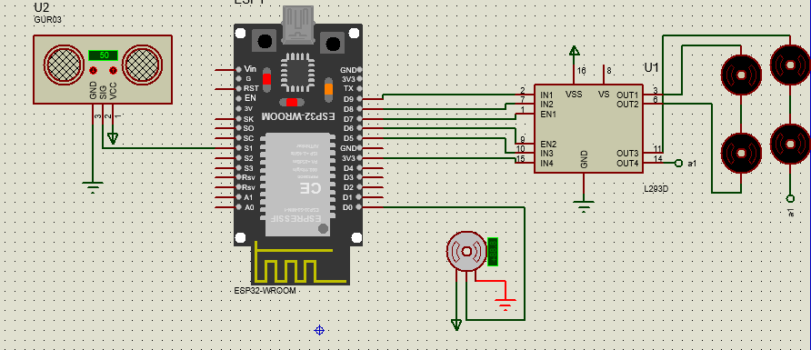
CIRCUIT DIAGRAM

Slide 6
TECHNOLOGY AND TOOLS
Python For Backend Control
Computer Vision
Google Cloud / Alexa
L293d Motor Driver
Ultrasonic sensor
Google Map API
Geared wheels
Servo motors
Esp32
Offline Voice Recognition Module
BRU speakers
Camera

Slide 7
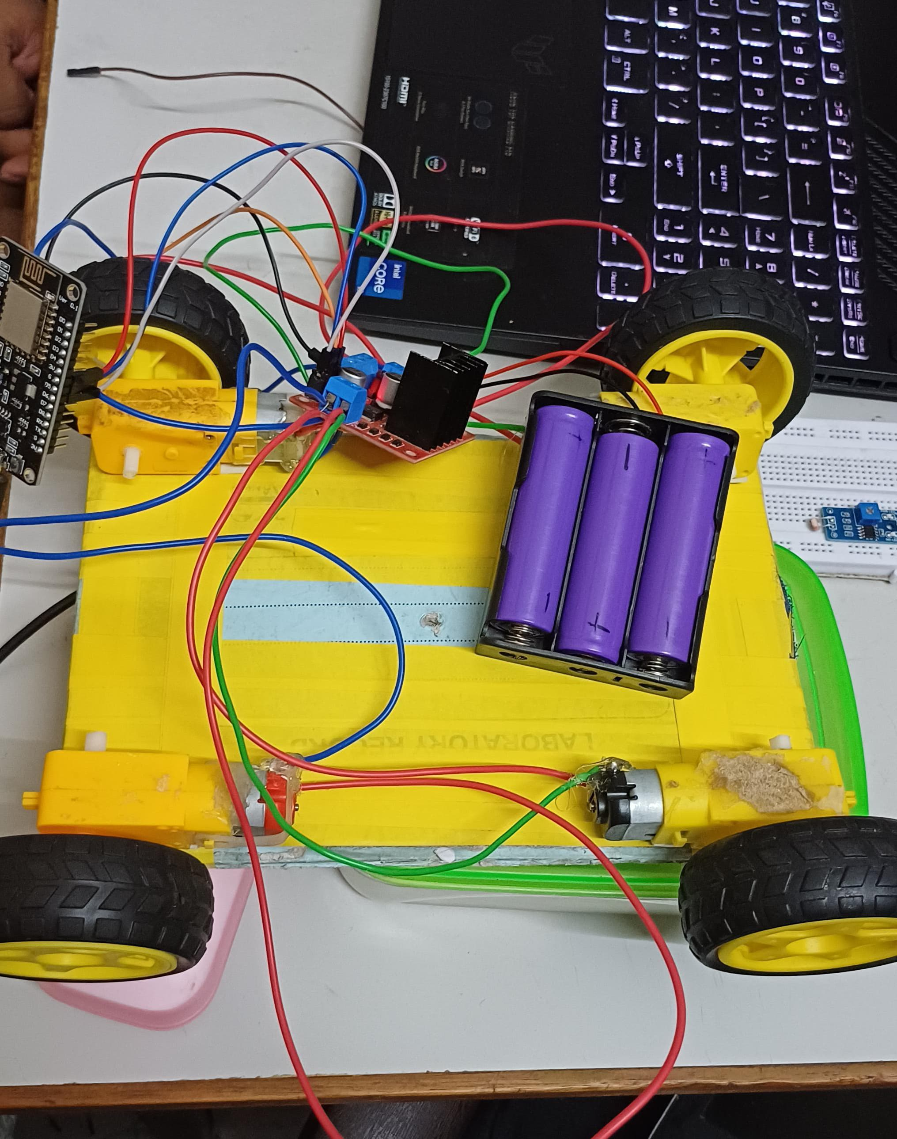

Slide 8
THANK YOU

